Slide 1
Cs1231S tutorial #9
Counting 1

Slide 2
Learning objectives of this tutorial
Counting
Applying multiplication rule, addition rule, difference rule and the inclusion/exclusion rule.
Applying permutation.
Learning about circular permutation.
Solving problems using the Pigeonhole Principle.

Slide 3
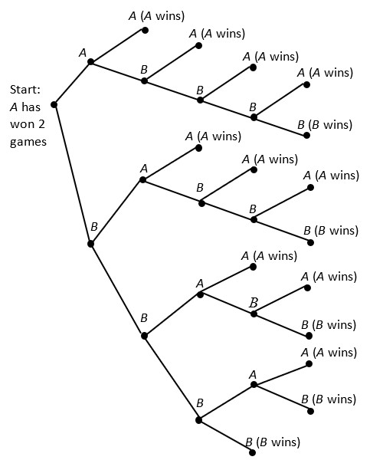
Q1.
Game: 3rd 4th 5th 6th 7th
A wins 4 games while B only wins 2 games.
The tournament ends.
First team to win 4 games wins the tournament. There are two teams A and B. Team A wins the first 2 games. How many ways can the tournament be completed?
A wins the 3rd game
How many ways?
B wins the 3rd game
We draw the possibility tree for this problem.
At each state (node), we have 2 possible scenarios,
A wins the current game or B wins the current game.
There are 15 ways in total.
B wins 4 games while A only wins 3 games.
The tournament ends.

Slide 4
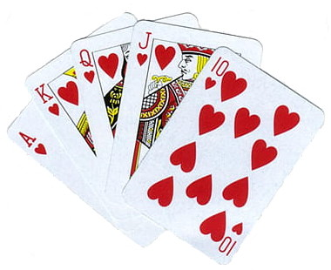




Q2.
You draw a sequence of 5 cards from a deck of cards with replacement.
(a) How many sequences will have at least one Queen?
Number of 5-card sequences =
$${52}^{5}$$
Number of 5-card sequences with no Queen =
$${48}^{5}$$
Number of 5-card sequences with at least one Queen =
$${52}^{5}−{48}^{5}$$
$$=125,499,064.$$
by Theorem 9.3.2 (difference rule)

Slide 5



Q2.
You draw a sequence of 5 cards from a deck of cards with replacement.
(b) How many sequences will have at least one Queen or one King?
Number of 5-card sequences =
$${52}^{5}$$
Number of 5-card sequences with no Queen and no King =
$${44}^{5}$$
Number of 5-card sequences with at least one Queen or one King =
$${52}^{5}−{44}^{5}$$
$$=215,287,808.$$
by Theorem 9.3.2 (difference rule)

Slide 6
Q3.
53
CS students: 789
All 3 modules: 46
CS1231S
CS1101S
MA1101R
672
629
153
How many CS students are not taking any of these 3 modules?
608
87
What theorem should you use?
Theorem 9.3.3 Inclusion/Exclusion Rule
1. Let $A$, $B$ and $C$ be the sets of CS students taking CS1231S, CS1101S and MA1101R respectively.
2. $\left|A∪B∪C\right|=\left|A\right|+\left|B\right|+\left|C\right|−\left|A∩B\right|−\left|A∩C\right|−\left|B∩C\right|+\left|A∩B∩C\right|$ $$=672+629+153−608−87−53+46=752$$
3. $\left|\overline{A}∩\overline{B}∩\overline{C}\right|=\left|\overline{\left(A∪B∪C\right)}\right|=\left|U\right|−\left|A∪B∪C\right|=789−752=37.$
4. There are 37 CS students who are not taking any of these three modules.

Slide 7
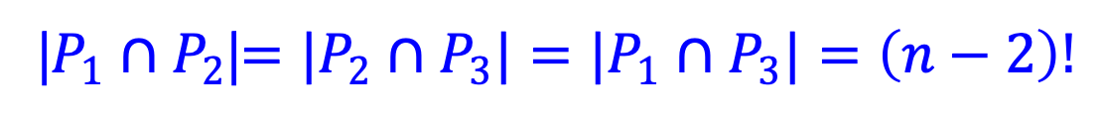
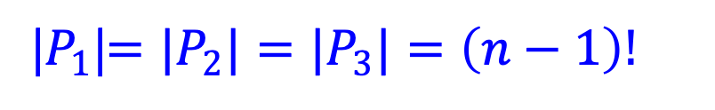
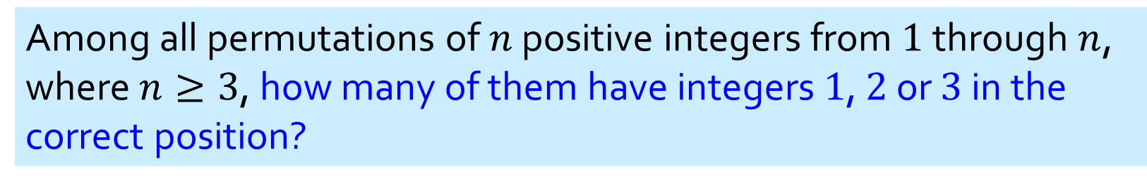
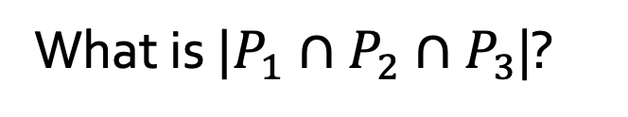

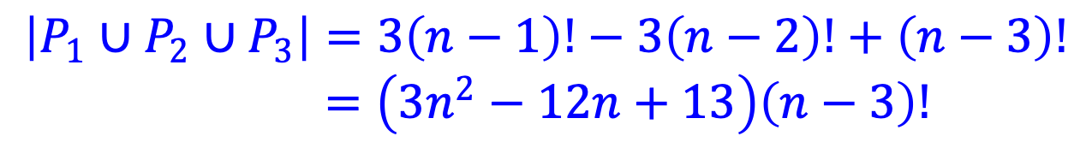

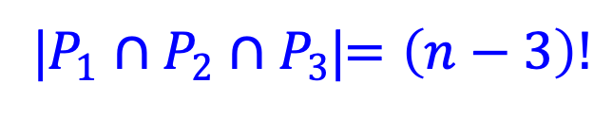
Q4.
Among all permutations of $n$ positive integers from $1$ through $n$, where $n≥3$, how many of them have integers $1$, $2$ or $3$ in the correct position?
Theorem 9.3.3 Inclusion/Exclusion Rule again!
Let $P_{k}$ be the permutations with integer $k$ in the correct position.
What is ${|P}_{1}|$? ${|P}_{2}|$? ${|P}_{3}|$?
|$P_{1}$|$=|P_{2}|=|P_{3}|=\left(n−1\right)!$
What is ${|P}_{1}∩P_{2}$|? ${|P}_{2}∩P_{3}|$? ${|P_{1}∩P}_{3}|$?
|$P_{1}∩P_{2}$|$=|P_{2}∩P_{3}|=|P_{1}∩P_{3}|=\left(n−2\right)!$
What is ${|P}_{1}∩P_{2}{∩P}_{3}$|?
|$P_{1}∩P_{2}∩P_{3}$|$=\left(n−3\right)!$
By the inclusion/exclusion rule (theorem 9.3.3),
$$\left|P_{1}∪P_{2}∪P_{3}\right|=3\left(n−1\right)!−3\left(n−2\right)!+\left(n−3\right)!$$
$=\left(3n^{2}−12n+13\right)\left(n−3\right)!$

Slide 8

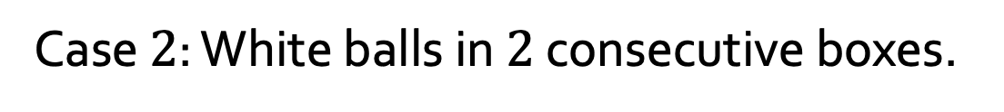

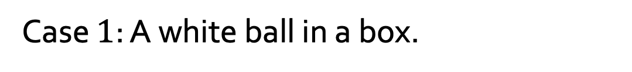

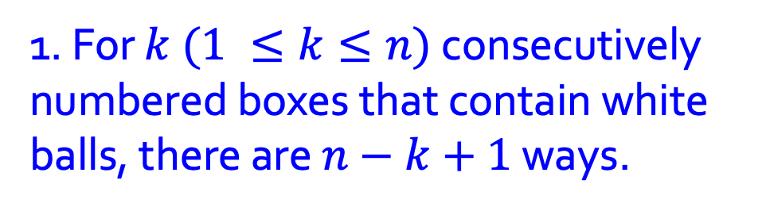
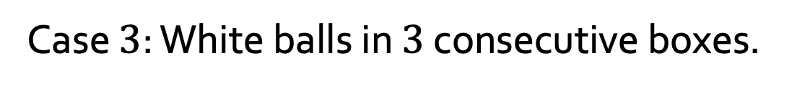
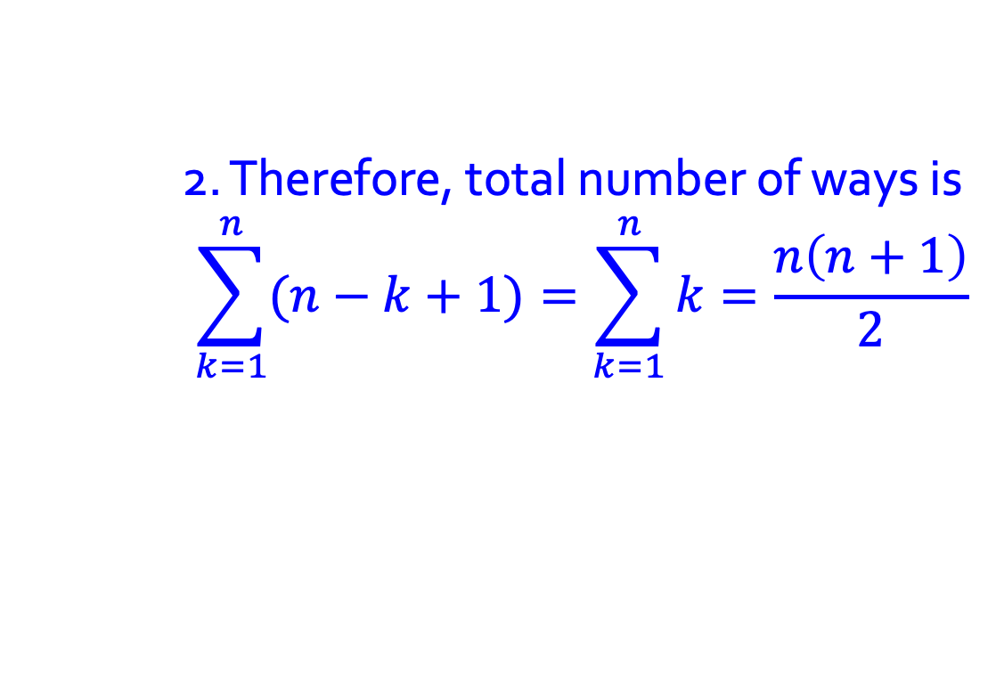
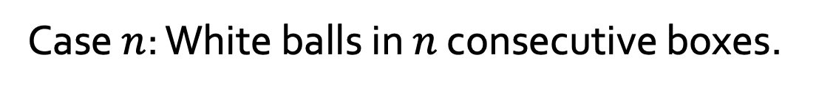

Q5.
Given n boxes numbered 1 to n, each box to be filled with a white ball or a blue ball. At least one box contains a white ball and boxes containing white balls must be consecutively numbered.
What is the total number of ways this can be done?
Case $1$: A white ball in a box.
$$n$$
Case $2$: White balls in $2$ consecutive boxes.
$$n−1$$
Case $3$: White balls in $3$ consecutive boxes.
$$n−2$$
:
Case $n$: White balls in $n$ consecutive boxes.
$$1$$
What rule to apply?
Addition rule.
1. For $k (1 ≤k≤n)$ consecutively numbered boxes that contain white balls, there are $n−k+1$ ways.
2. Therefore, total number of ways is
$$\sum_{k=1}^{n}{(n−k+1)}=\sum_{k=1}^{n}{k}=\frac{n\left(n+1\right)}{2}$$

Slide 9
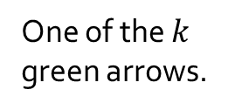

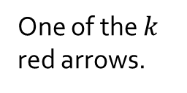
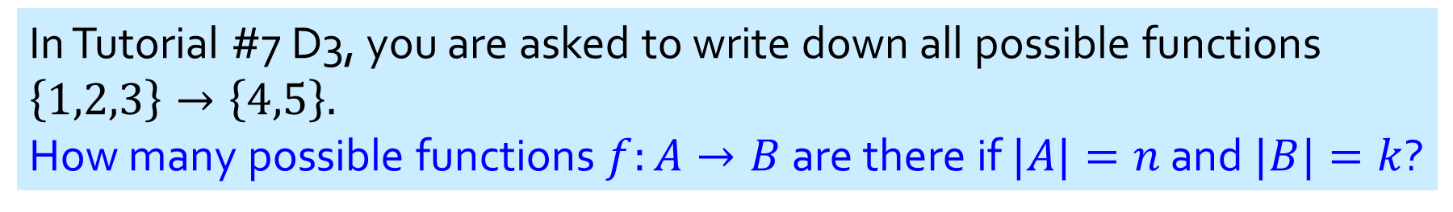
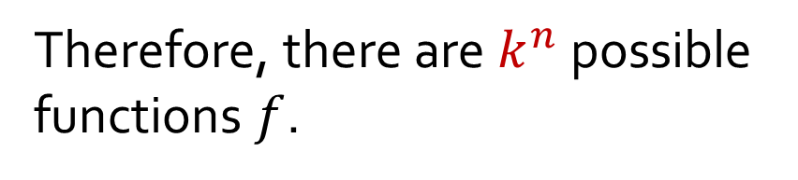
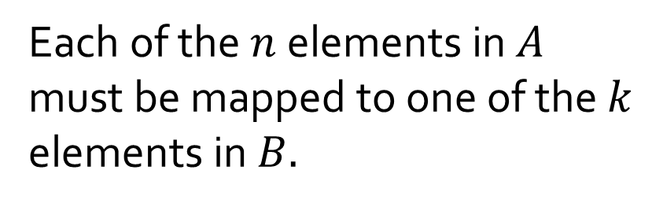

Q6.
In Tutorial #7 D3, you are asked to write down all possible functions $\left\{1,2,3\right\}→\left\{4,5\right\}.$
How many possible functions $f:A→B$ are there if $|A|=n$ and $|B|=k$?
$$A$$
$$B$$
One of the $k$ green arrows.
Each of the $n$ elements in $A$ must be mapped to one of the $k$ elements in $B.$
:
:
Therefore, there are $k^{n}$ possible functions $f$.
One of the $k$ red arrows.

Slide 10



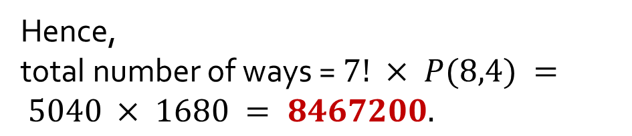
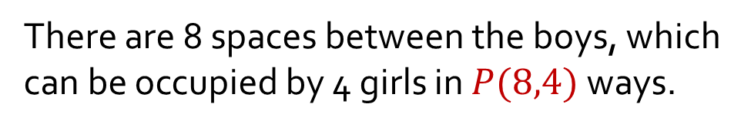
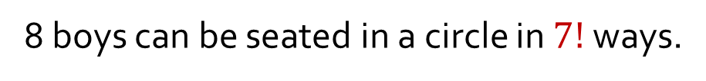

Q7.
(a) In how many ways can 8 boys and 4 girls sit around a circular table, so that no two girls sit together?
We sit the boys first, then sit each girl in between the boys so that no two girls will sit together.
8 boys can be seated in a circle in $7!$ ways.
There are 8 spaces between the boys, which can be occupied by 4 girls in $P(8,4)$ways.
Hence,
total number of ways = $7! × P(8,4) = 5040 × 1680 = 8467200.$

Slide 11
Q7.
(b) In how many ways can 6 people sit around a circular table, but Eric would not sit next to Freddy?
There are 5! = 120 ways for 6 people to sit around a circular table.
Eric
There are 2 × 4! = 48 ways for Eric and Freddy to sit together.
Therefore, the answer is 120 – 48 = 72 ways.
Freddy

Slide 12
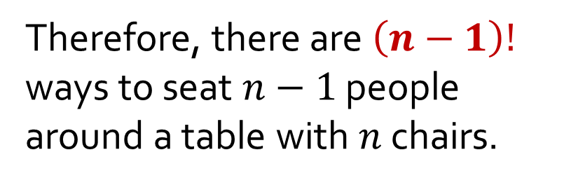
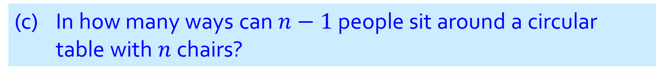
Q7.
(c) In how many ways can $n−1$ people sit around a circular table with $n$ chairs?
Treat the empty chair as just another person.
Therefore, there are $\left(n−1\right)!$ ways to seat $n−1$ people around a table with $n$ chairs.

Slide 13
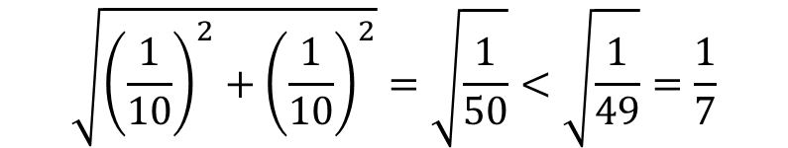
Q8.
Prove that if you randomly put 51 points inside a unit square, there are always 3 points that can be covered by a circle of radius 1/7.
1. Divide the unit square into 25 equal smaller squares of side 1/5 each.
2. Now, at least one of these small squares would contain at least 3 points. (Why?)
3. Now, the circle circumvented around the small square with the 3 points inside also contains these 3 points as it has radius
$$\sqrt{{\left(\frac{1}{10}\right)}^{2}+{\left(\frac{1}{10}\right)}^{2}}=\sqrt{\frac{1}{50}}<\sqrt{\frac{1}{49}}=\frac{1}{7}$$

Slide 14

Q8.
Prove that if you randomly put 51 points inside a unit square, there are always 3 points that can be covered by a circle of radius 1/7.
1. Divide the unit square into 16 equal smaller squares of side 1/4 each.
WRONG ANSWER!
(Why?)
2. Now, at least one of these small squares would contain at least 3 points. (Why?)
3. Now, the area of a small square is 1/16=0.0625, which is smaller than the area of a circle of radius 1/7 which is 0.0641.
Although the area of the small square < area of the circle, the radius of the smallest circle that covers the small square completely is
$$\sqrt{{\left(\frac{1}{8}\right)}^{2}+{\left(\frac{1}{8}\right)}^{2}}=\sqrt{\frac{1}{32}}>\frac{1}{7}$$

Slide 15
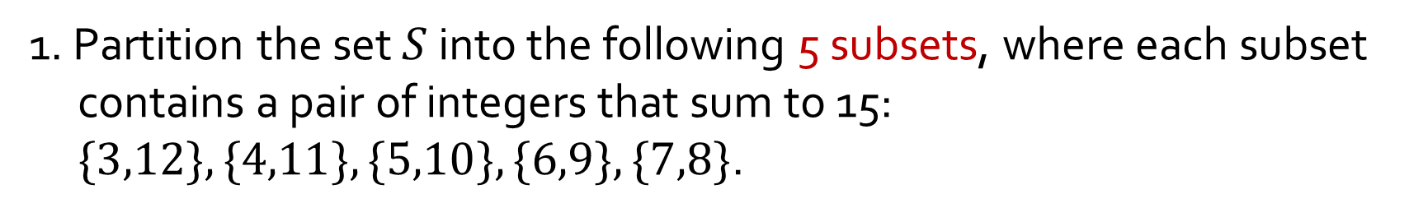
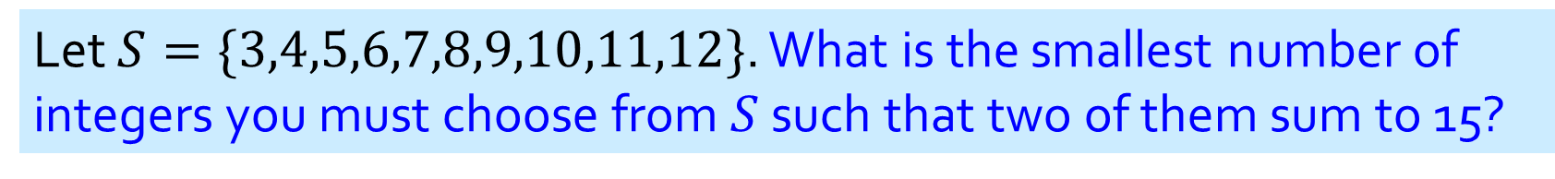
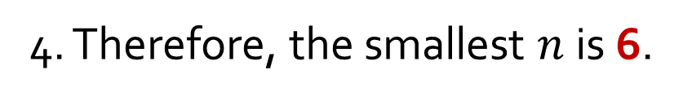
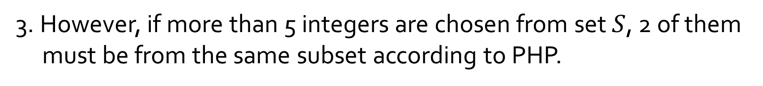
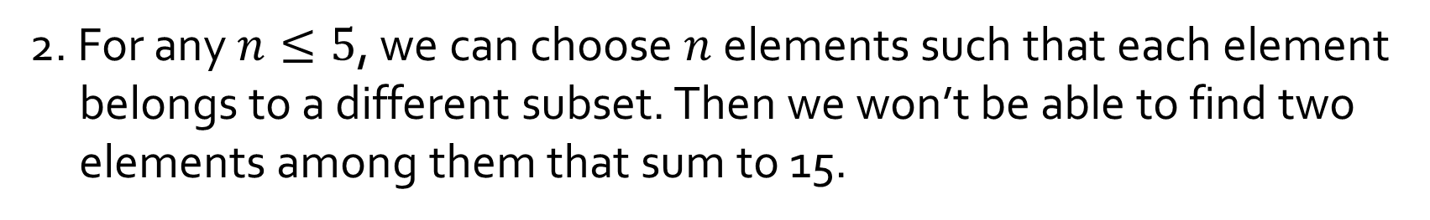
Q9.
Let $S=\{3,4,5,6,7,8,9,10,11,12\}$. What is the smallest number of integers you must choose from $S$ such that two of them sum to 15?
1. Partition the set $S$ into the following 5 subsets, where each subset contains a pair of integers that sum to 15: $\{3,12\}, \{4,11\}, \{5,10\}, \{6,9\},\{7,8\}$.
6 pigeons; 5 pigeonholes.
2. For any $n≤5$, we can choose $n$ elements such that each element belongs to a different subset. Then we won’t be able to find two elements among them that sum to 15.
3. However, if more than 5 integers are chosen from set $S$, 2 of them must be from the same subset according to PHP.
4. Therefore, the smallest $n$ is 6.

Slide 16
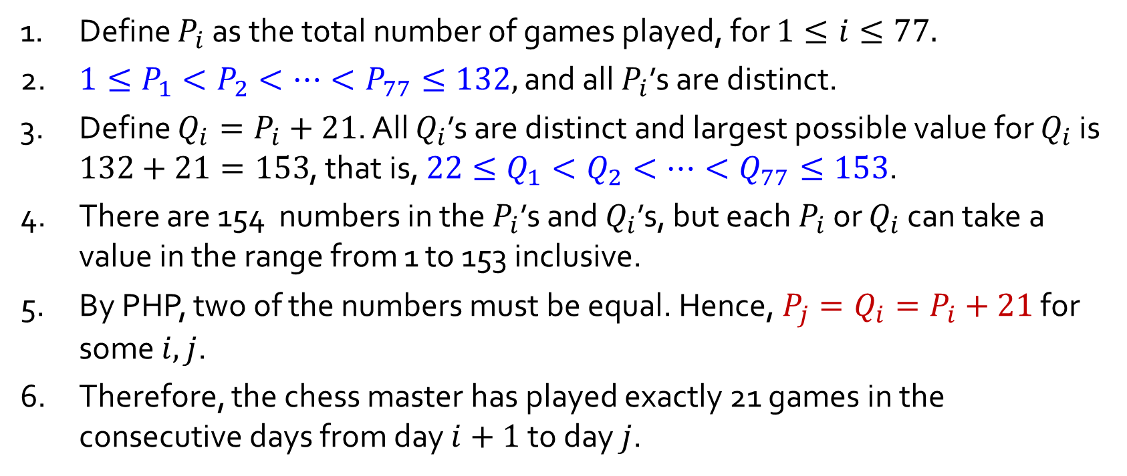
Q10.
A chess master who has 11 weeks to prepare for a tournament decides to play at least one game every day, but in order not to tire herself, she decides not to play more than 12 games during any one week. Show that there exists a succession of consecutive days during which the chess master will have played exactly 21 games.
1. Define $P_{i}$ as the total number of games played, for $1≤i≤77.$
2. $1≤P_{1}<P_{2}<⋯<P_{77}≤132,$ and all $P_{i}$’s are distinct.
3. Define $Q_{i}=P_{i}+21$. All $Q_{i}$’s are distinct and largest possible value for $Q_{i}$ is $132+21=153$, that is, $22≤Q_{1}<Q_{2}<⋯<Q_{77}≤153$.
4. There are 154 numbers in the $P_{i}$’s and $Q_{i}$’s, but each $P_{i}$ or $Q_{i}$ can take a value in the range from 1 to 153 inclusive.
5. By PHP, two of the numbers must be equal. Hence, $P_{j}=Q_{i}=P_{i}+21$ for some $i,j$.
6. Therefore, the chess master has played exactly 21 games in the consecutive days from day $i+1$ to day $j$.

Slide 17
THE END

